Slide 2
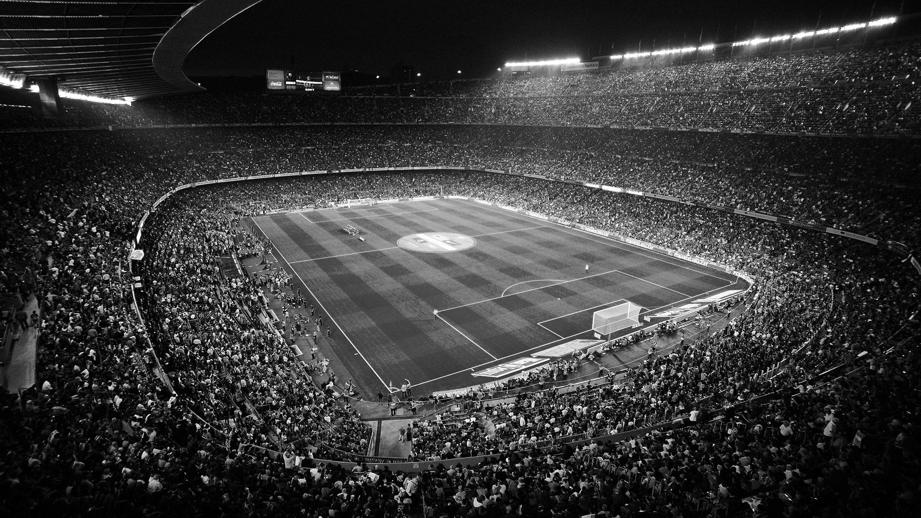
English Premier League
The Premier League is the most-watched sports league in the world, broadcast in 212 territories to 643 million homes and a potential TV audience of 4.7 billion people.
Total attendance at English Premier League games last year was 14.5 million.
As much as one billion euros is gambled globally on every English Premier League game

Slide 3
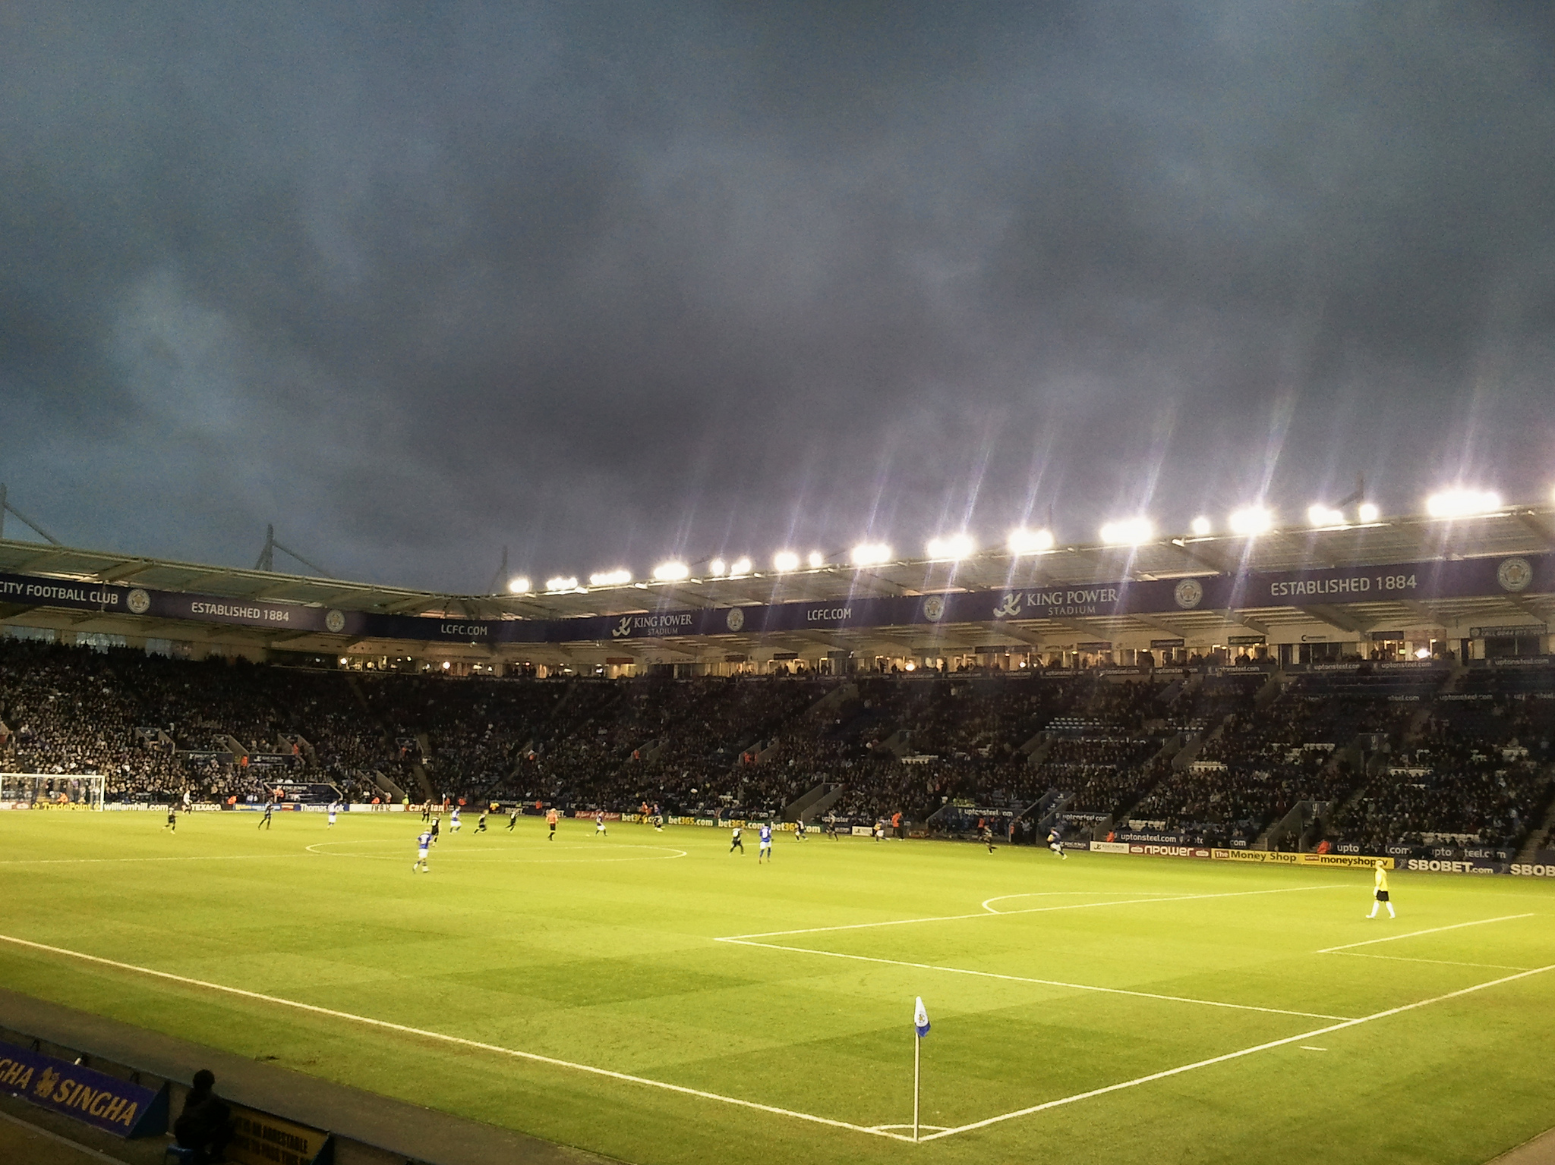
The Overall Concept
Provide a robust UI including :
Real time scores
Team specific statistics, including matches played with video highlights
Upcoming league games
League standings
Interactive fan message board

Slide 4
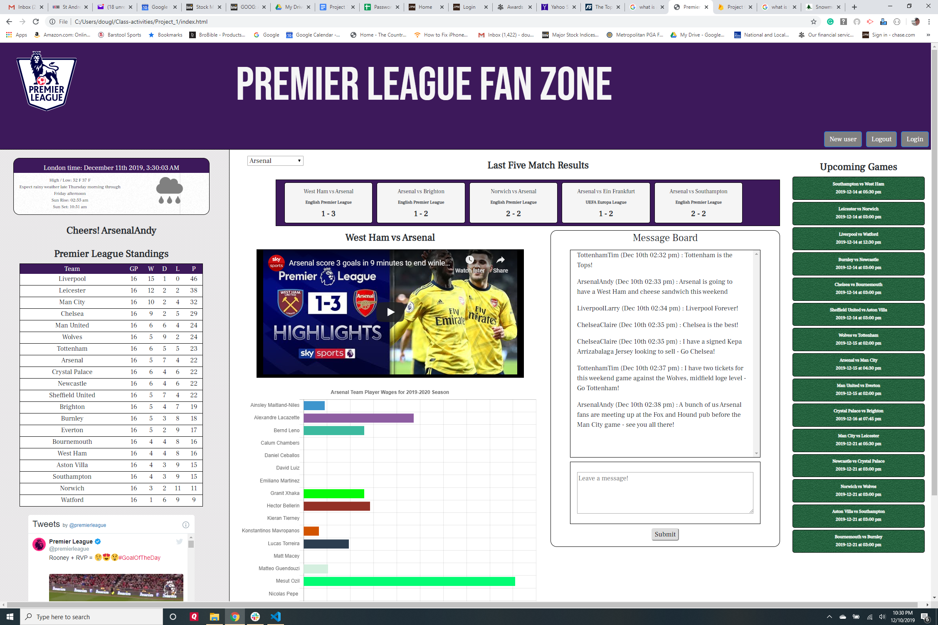

Slide 5

Web Development Boot Camp
Project 1 Presentation
Team M.A.D.

Slide 6

Collaborators
Mike Lang
Alex Fernandez
Doug Mueller

Slide 7











Technologies Used

Slide 8

Application Demo

Slide 9

Future Developments
The ability to link user sports betting accounts
Links to team merchandise and memorabilia
Links to game tickets purchasing
The ability for event advertising

Slide 10

THE END Thank You!

